Slide 1


A Low-Latency Online Prediction Serving System
Clipper
Dan Crankshaw
crankshaw@cs.berkeley.edu
http://clipper.ai
https://github.com/ucbrise/clipper
March 16, 2018

Slide 2
Learning
Big
Data
Training
Complex Model

Slide 3
Learning Produces a Trained Model
Query
Decision
“CAT”
Model

Slide 4
Learning
Serving
Query
Big
Data
?
Training
Decision
Model
Application

Slide 5
Serving
Learning
Query
Big
Data
Training
Decision
Model
Application
Prediction-Serving for interactive applications
Timescale: ~10s of milliseconds

Slide 6
In this talk…
Challenges of prediction serving
Clipper overview and architecture
From research prototype to open-source system
Serving multi-model pipelines
Notes:
”Abstract away the model behind a uniform API”

Slide 7
Prediction-Serving Raises New Challenges

Slide 8








Prediction-Serving Challenges
???
Create
VW
Caffe
8
Large and growing ecosystem of ML models and frameworks
Support low-latency, high-throughput serving workloads

Slide 9
Support low-latency, high-throughput serving workloads
Models getting more complex
10s of GFLOPs [1]
Deployed on critical path
Maintain SLOs under heavy load
Using specialized hardware for predictions
[1] Deep Residual Learning for Image Recognition. He et al. CVPR 2015.
Notes:
FLOPs, numbers for models,

Slide 10
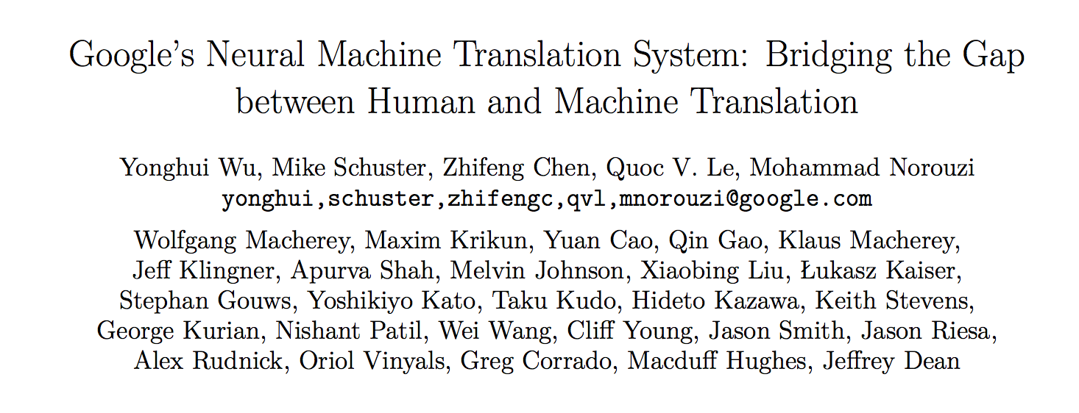
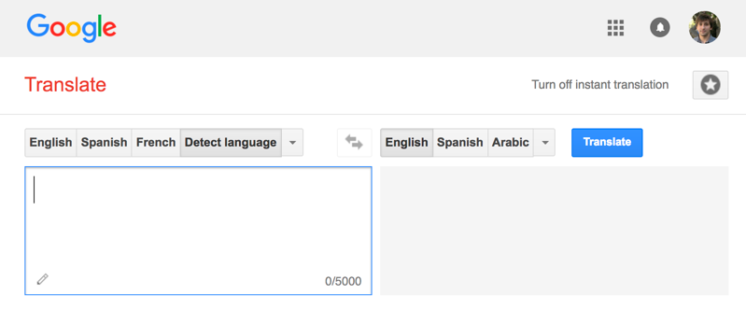
Google Translate
Serving
Invented New Hardware!
Tensor Processing Unit (TPU)
140 billion words a day¹
82,000 GPUs running 24/7
[1] https://www.nytimes.com/2016/12/14/magazine/the-great-ai-awakening.html
Notes:
Model scoring that drove Google to develop new hardware, not training

Slide 11

Big Companies Build One-Off Systems
Problems:
Expensive to build and maintain
Highly specialized and require ML and systems expertise
Tightly-coupled model and application
Difficult to change or update model
Only supports single ML framework

Slide 12
Prediction-Serving Challenges
???
Create
VW
Caffe
12
Large and growing ecosystem of ML models and frameworks
Support low-latency, high-throughput serving workloads

Slide 13
But building new serving systems for each framework is expensive…

Slide 14
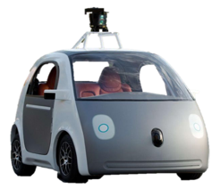






Large and growing ecosystem of ML models and frameworks
Fraud Detection
Content
Rec.
Personal
Asst.
Robotic
Control
Machine
Translation
???
VW
Create
Caffe
14
Notes:
Different models, different frameworks have different strengths
Give example of why all are needed
Multiple applications with different needs within an org
Even a single application may need to support multiple frameworks

Slide 15
Use existing systems: Offline Scoring
Big
Data
Training
Model
Batch Analytics

Slide 16
Use existing systems: Offline Scoring
Datastore
Big
Data
X | Y
Training
Scoring
Model
Batch Analytics

Slide 17
Use existing systems: Offline Scoring
Look up decision in datastore
Query
X | Y
Decision
Application
Low-Latency Serving

Slide 18
Use existing systems: Offline Scoring
Look up decision in datastore
Problems:
Requires full set of queries ahead of time
Small and bounded input domain
Wasted computation and space
Can render and store unneeded predictions
Costly to update
Re-run batch job
Query
X | Y
Decision
Application
Low-Latency Serving

Slide 19
Prediction-Serving Today
Query
Clipper aims to unify these approaches
X | Y
Decision
Highly specialized systems for specific problems
Offline scoring with existing frameworks and systems

Slide 20
What would we like this to look like?
Fraud Detection
Content
Rec.
Personal
Asst.
Robotic
Control
Machine
Translation
???
VW
Create
Caffe
20
Notes:
Different models, different frameworks have different strengths
Give example of why all are needed
Multiple applications with different needs within an org
Even a single application may need to support multiple frameworks

Slide 21
Encapsulate each system in isolated environment
Fraud Detection
Content
Rec.
Personal
Asst.
Robotic
Control
Machine
Translation
???
VW
Create
Caffe
21
Notes:
Different models, different frameworks have different strengths
Give example of why all are needed
Multiple applications with different needs within an org
Even a single application may need to support multiple frameworks

Slide 22



Decouple models and applications
Fraud Detection
Content
Rec.
Personal
Asst.
Robotic
Control
Machine
Translation
???
Caffe
VW
22
Create
Notes:
Different models, different frameworks have different strengths
Give example of why all are needed
Multiple applications with different needs within an org
Even a single application may need to support multiple frameworks

Slide 23
Clipper Decouples Applications and Models
Applications
Predict
Clipper
RPC
RPC
RPC
RPC
Model Container (MC)
MC
MC
MC
Caffe
VW
Create

Slide 24
Clipper Implementation
Applications
Predict
Clipper
Core system: 10,000 lines of C++ and 8,000 lines of Python
Open source system: https://github.com/ucbrise/clipper
Goal: Community-owned platform for model deployment and serving
Model Abstraction Layer
Caching
Adaptive Batching
RPC
RPC
RPC
RPC
Model Container (MC)
MC
MC
MC
Caffe
Notes:
Put github link

Slide 25



Clipper Implementation
clipper
admin
Applications
Predict
Clipper
Query Processor
Clipper
Management
Prometheus
Monitoring
Redis
ConfigDB
Model Container
Model Container

Slide 26
Run on Kubernetes alongside other applications
Web Server
Other applications
Other applications
Clipper
Cache
Other applications
MC
Database
Other applications

Slide 27
Getting Started with Clipper
Docker images available on DockerHub
Clipper admin is distributed as pip package:
pip install clipper_admin
Get up and running without cloning or compiling!
Notes:
so all you need to do to launch a Clipper cluster is pip install

Slide 28
Technologies inside Clipper
Containerized frameworks: unified abstraction and isolation
Cross-framework caching and batching: optimize throughput and latency
Cross-framework model composition: improved accuracy through ensembles and bandits
Notes:
”Abstract away the model behind a uniform API”

Slide 29
Clipper Decouples Applications and Models
Applications
Predict
RPC/REST Interface
Feedback
Clipper
RPC
RPC
RPC
RPC
Model Container (MC)
MC
MC
MC
Caffe
VW
Create

Slide 30
Clipper Decouples Applications and Models
Applications
Predict
RPC/REST Interface
Feedback
Clipper
RPC
RPC
RPC
RPC
Model Container (MC)
MC
MC
MC
Caffe
VW
Create

Slide 31
Clipper Decouples Applications and Models
Applications
Predict
RPC/REST Interface
Feedback
Clipper
RPC
RPC
RPC
RPC
Model Container (MC)
MC
MC
MC
Caffe
VW
Create
Common Interface → Simplifies Deployment:
Evaluate models using original code & systems

Slide 32
Container-based Model Deployment
Implement Model API:
class ModelContainer:
def __init__(model_data)
def predict_batch(inputs)
Notes:
Black-box abstraction

Slide 33
Container-based Model Deployment
Implement Model API:
class ModelContainer:
def __init__(model_data)
def predict_batch(inputs)
API support for many programming languages
Python
Java
C/C++
Notes:
Data scientist doesn’t have to learn any new skills

Slide 34
Container-based Model Deployment
Package model implementation and dependencies
Model Container (MC)
class ModelContainer:
def __init__(model_data)
def predict_batch(inputs)
VW
Create

Slide 35
Container-based Model Deployment
Clipper
RPC
RPC
RPC
RPC
Model Container (MC)
MC
MC
MC
Caffe
VW
Create
Notes:
From the frontend dev perspective Clipper

Slide 36
Clipper Decouples Applications and Models
Applications
Predict
RPC/REST Interface
Feedback
Clipper
RPC
RPC
RPC
RPC
Model Container (MC)
MC
MC
MC
Caffe
VW
Create
Common Interface → Simplifies Deployment:
Evaluate models using original code & systems
Models run in separate processes as Docker containers
Resource isolation: Cutting edge ML frameworks can be buggy

Slide 37
Clipper Decouples Applications and Models
Applications
Predict
RPC/REST Interface
Feedback
Clipper
RPC
RPC
RPC
RPC
RPC
RPC
Model Container (MC)
MC
MC
MC
MC
MC
Caffe
Common Interface → Simplifies Deployment:
Evaluate models using original code & systems
Models run in separate processes as Docker containers
Resource isolation: Cutting edge ML frameworks can be buggy
Scale-out

Slide 38
Technologies inside Clipper
Containerized frameworks: unified abstraction and isolation
Cross-framework caching and batching: optimize throughput and latency
Cross-framework model composition: improved accuracy through ensembles and bandits

Slide 39




Clipper Architecture
Applications
Predict
RPC/REST Interface
Observe
Clipper
Model Abstraction Layer
Caching
Latency-Aware Batching
RPC
RPC
RPC
RPC
Model Container (MC)
MC
MC
MC
Caffe

Slide 40
Batching to Improve Throughput
Why batching helps:
Optimal batch depends on:
hardware configuration
model and framework
system load
A single
page load may generate
many queries
Throughput-optimized frameworks
Throughput
Batch size
Notes:
Make clearer that batching navigates tradeoff between throughput and latency

Slide 41
Batching to Improve Throughput
Latency-aware
Why batching helps:
Optimal batch depends on:
hardware configuration
model and framework
system load
A single
page load may generate
many queries
Clipper Solution:
Adaptively tradeoff latency and throughput…
Inc. batch size until the latency objective is exceeded (Additive Increase)
If latency exceeds SLO cut batch size by a fraction (Multiplicative Decrease)
Throughput-optimized frameworks
Throughput
Batch size
Notes:
Make clearer that batching navigates tradeoff between throughput and latency

Slide 42
Tensor Flow Conv. Net (GPU)
Better
Throughput (Queries Per Second)
Batch Size
Notes:
Two plots, thorughput on top, latency on bottom

Slide 43
Tensor Flow Conv. Net (GPU)
Better
Throughput (Queries Per Second)
Latency (ms)
Better
Batch Size
Notes:
Two plots, thorughput on top, latency on bottom

Slide 44
Tensor Flow Conv. Net (GPU)
Better
Throughput (Queries Per Second)
Optimal Batch Size
Latency (ms)
Better
Batch Size
Notes:
Two plots, thorughput on top, latency on bottom

Slide 45
Batching to Improve Throughput
Latency-aware
Better
Throughput
(QPS)

Slide 46
Research Prototype to Active Open-Source Project

Slide 47
RISE Stack (January 2018)
Mixed-autonomy
Traffic
Pylot
(self-driving platform)
Cloud robotics
Smart Buildings
Applications
Jarvis
Tegra
Opaque
Drizzle
Clipper
PyWren
Processing
RAY
TensorFlow, PyTorch, MXNet, Caffe2, …
Spark
RLlib
Ray Tune
Ground
(context metadata service)
WAVE
(decentralized authorization service)
Confluo
(formerly DiaLog)
HDFS, Kafka, Cassandra, DBMSes, …
Infrastructure
(cluster manager,
storage, authorization &
authentication,
metadata management, …)
FireSim
AWS, Azure, GCE, Kubernetes, Mesos, …

Slide 48
Status of the project
Threw away the research prototype and rewrote the system from scratch in C++
First released in May 2017 with a focus on usability
Development has focused on performance improvements, support for cloud deployments, and increased support for common machine learning frameworks
Supports native deployments on Kubernetes and a local Docker mode
First class support for several common machine learning frameworks: PyTorch, TensorFlow, Scikit-Learn, PySpark, R
22 contributors
Including 8 from outside Berkeley

Slide 49
Project Goals
Community-owned platform for model deployment and serving
Research platform for continued investigation into model serving and management

Slide 50
Development Roadmap: Spring 2018
More explicit support for distributed cloud deployments
Support for running Clipper in replicated and partitioned modes for high-availability and scalability
Performance Optimizations
A recent research fork introduced several performance optimizations that are in the process of being ported back to the mainline code base
Metrics and Monitoring infrastructure using Prometheus
Comprehensive monitoring is critical for production infrastructure
Increased community outreach
We want community feedback on what is working, and what is not!

Slide 51
Research Roadmap
Support for increasingly complex machine-learning applications
InferLine: Serving multi-model pipelines on heterogeneous hardware
Serving RL policies and integration with Ray
Closing the loop between training and serving
Online model evaluation and monitoring to detect problems ASAP
Automatically decide when and how to retrain models
Integration of online learning and bandit algorithms with offline batch training

Slide 52
Serving Multi-Model Pipelines with InferLine (Work In Progress)

Slide 53
Technologies inside Clipper
Containerized frameworks: unified abstraction and isolation
Cross-framework caching and batching: optimize throughput and latency
Cross-framework model composition: improved accuracy through ensembles and bandits
*Explored in research prototype
[NSDI 2017]
Notes:
”Abstract away the model behind a uniform API”

Slide 54
Clipper Architecture
Applications
Predict
RPC/REST Interface
Observe
Clipper
Model Selection Layer
Selection Policy
Model Abstraction Layer
RPC
RPC
RPC
RPC
Model Container (MC)
MC
MC
MC
Caffe
Notes:
because model-abstraction layer lets you plug in many models, model selection layer chooses between them
introduce learning in selection layer later

Slide 55


Applications
Predict
RPC/REST Interface
Observe
Clipper
Model Selection Layer
Selection Policy
Exploit multiple models to estimate confidence
Use multi-armed bandit algorithms to learn optimal model-selection online
Online personalization across ML frameworks

Slide 56
Applications
Predict
RPC/REST Interface
Observe
Clipper
Model Selection Layer
Selection Policy
Version 1
Periodic retraining
Version 2
Version 3
Experiment with new models and frameworks
Notes:
By combining predictions from multiple models we can improve application accuracy and quantify confidence in predictions

Slide 57
Selection Policy: Estimate confidence
Version 2
Version 3
“CAT”
“CAT”
CONFIDENT
“CAT”
Policy
“CAT”
“CAT”

Slide 58
Selection Policy: Estimate confidence
“CAT”
“CAT”
UNSURE
“MAN”
Policy
“CAT”
“SPACE”
Notes:
“Not a cat picture”

Slide 59
Trends in Applied Machine Learning
Else
Slow but accurate model
Task-specific model
If face detected
Face detector
If object detected
Fast model
If confident then return
Pre-trained DNN
Object detector
Ensembles can improve accuracy
Faster inference with prediction cascades
Faster development through model-reuse
Model specialization
How to efficiently support serving arbitrary model pipelines?

Slide 60
Model Composition Patterns
Ensembles
AND
Model 1
Model 2
…
Model m
Notes:
In fact, we’ve identified a number of practically motivated model composition patterns:
Ensembles : querying multiple models to render more accurate predictions

Slide 61
Model Composition Patterns
Multi-armed bandits
OR
p1
p2
pi
pm
Bandit 1
Bandit 2
…
Bandit m
Notes:
Bandit-stile algorithms

Slide 62
Model Composition Patterns
Neural Features/Models as transformers
Model 1
…
Model m
Notes:
Conditional execution models where models are exucuted conditionally , for various reasons,
For example

Slide 63
Model Composition Patterns
Cascades
p1
Model 1
p2
Model 2
pi
…
pm
Model m
Ref: Xin Wang et al, IDK Cascades: Fast Deep Learning by Learning not to Overthink
Notes:
Conditional execution models where models are exucuted conditionally , for various reasons,
For example

Slide 64
Model Composition Patterns
E.g. ensemble of Cascades
p11
p21
Model11
Model21
p12
p22
Model12
Model22

Slide 65
Model Serving Considerations
throughput
Latency (ms)
Latency SLO
Batch size
Notes:
For all of these models, deploying even a single model requires us to think about the effect of controlling various model parameters for optimal performance.
For example, picking a batch size has a profound and varied effect on throughput as well as latency. Yet simply going with the maximum batch size may be undesirable if we’re dealing with latency SLOs.
Optimally configuring models even for a single model deployment proved in itself a challenge and warranted discussion in the preceding NSDI 2017 paper.

Slide 66
Global Reasoning: Motivating Example
Model 1
Model 2
Latency SLO = 300ms
Batch size | throughput | Latency(ms)
1 | 40 | 80
5 | 80 | 150
10 | 100 | 180
Batch size | throughput | Latency(ms)
1 | 10 | 100
5 | 20 | 150
10 | 30 | 200
Notes:
Now let us see what happens when you have multiple models in a pipeline.
Let’s say we have these two models, m1 and m2, with the output of m1 serving as input to m2.
And let’s say that the profiler told us that throughput and latency for model 1 depend on batch size in the following way.
So, you might be tempted to maximize throughput greedily by setting the batch size to its maximum setting. If you do that, however,
You will leave only 120ms of slack for model m2, which leaves you with but a single option for model 2 batch size.
And we end up in a suboptimal configuration setting. Turns on the second model is a bottleneck, so, with batch size of 1, it yields the throughput of 10qps, which becomes the throughput of the overall pipeline.
If we were to go with the smallest batch size for model 1 and the largest batch size for model 2, you have 3x improvement in overall pipeline throughput from 10 qps to 30 qps.
-----------------------
Let us look at an example of configuring a pipeline that consists of two models m1 and m2. Let’s say for m1 we have the following relationship between the batch size and the models throughput and latency.
…
And for m2 we have this relationship.
If you were to greedily maximize throughput for m1, you might choose batch size of 10,

Slide 67
Global Reasoning: Motivating Example
Model 1
Model 2
Latency SLO = 300ms
Batch size | throughput | Latency(ms)
1 | 40 | 80
5 | 80 | 150
10 | 100 | 180
Batch size | throughput | Latency(ms)
1 | 10 | 100
5 | 20 | 150
10 | 30 | 200
Notes:
Now let us see what happens when you have multiple models in a pipeline.
Let’s say we have these two models, m1 and m2, with the output of m1 serving as input to m2.
And let’s say that the profiler told us that throughput and latency for model 1 depend on batch size in the following way.
So, you might be tempted to maximize throughput greedily by setting the batch size to its maximum setting. If you do that, however,
You will leave only 120ms of slack for model m2, which leaves you with but a single option for model 2 batch size.
And we end up in a suboptimal configuration setting. Turns on the second model is a bottleneck, so, with batch size of 1, it yields the throughput of 10qps, which becomes the throughput of the overall pipeline.
If we were to go with the smallest batch size for model 1 and the largest batch size for model 2, you have 3x improvement in overall pipeline throughput from 10 qps to 30 qps.
-----------------------
Let us look at an example of configuring a pipeline that consists of two models m1 and m2. Let’s say for m1 we have the following relationship between the batch size and the models throughput and latency.
…
And for m2 we have this relationship.
If you were to greedily maximize throughput for m1, you might choose batch size of 10,

Slide 68
Global Reasoning: Motivating Example
Model 1
Model 2
Latency SLO = 300ms
Batch size | throughput | Latency(ms)
1 | 40 | 80
5 | 80 | 150
10 | 100 | 180
Batch size | throughput | Latency(ms)
1 | 10 | 100
5 | 20 | 150
10 | 30 | 200
bs1 = 10 → throughput1 = 100
Notes:
Now let us see what happens when you have multiple models in a pipeline.
Let’s say we have these two models, m1 and m2, with the output of m1 serving as input to m2.
And let’s say that the profiler told us that throughput and latency for model 1 depend on batch size in the following way.
So, you might be tempted to maximize throughput greedily by setting the batch size to its maximum setting. If you do that, however,
You will leave only 120ms of slack for model m2, which leaves you with but a single option for model 2 batch size.
And we end up in a suboptimal configuration setting. Turns on the second model is a bottleneck, so, with batch size of 1, it yields the throughput of 10qps, which becomes the throughput of the overall pipeline.
If we were to go with the smallest batch size for model 1 and the largest batch size for model 2, you have 3x improvement in overall pipeline throughput from 10 qps to 30 qps.
-----------------------
Let us look at an example of configuring a pipeline that consists of two models m1 and m2. Let’s say for m1 we have the following relationship between the batch size and the models throughput and latency.
…
And for m2 we have this relationship.
If you were to greedily maximize throughput for m1, you might choose batch size of 10,

Slide 69
Global Reasoning: Motivating Example
Model 1
Model 2
Latency SLO = 300ms
Batch size | throughput | Latency(ms)
1 | 40 | 80
5 | 80 | 150
10 | 100 | 180
Batch size | throughput | Latency(ms)
1 | 10 | 100
5 | 20 | 150
10 | 30 | 200
bs1 = 10 → throughput1 = 100
bs2 = 1 → throughput2 = 10
Pipeline throughput = 10
Notes:
Now let us see what happens when you have multiple models in a pipeline.
Let’s say we have these two models, m1 and m2, with the output of m1 serving as input to m2.
And let’s say that the profiler told us that throughput and latency for model 1 depend on batch size in the following way.
So, you might be tempted to maximize throughput greedily by setting the batch size to its maximum setting. If you do that, however,
You will leave only 120ms of slack for model m2, which leaves you with but a single option for model 2 batch size.
And we end up in a suboptimal configuration setting. Turns on the second model is a bottleneck, so, with batch size of 1, it yields the throughput of 10qps, which becomes the throughput of the overall pipeline.
If we were to go with the smallest batch size for model 1 and the largest batch size for model 2, you have 3x improvement in overall pipeline throughput from 10 qps to 30 qps.
-----------------------
Let us look at an example of configuring a pipeline that consists of two models m1 and m2. Let’s say for m1 we have the following relationship between the batch size and the models throughput and latency.
…
And for m2 we have this relationship.
If you were to greedily maximize throughput for m1, you might choose batch size of 10,

Slide 70
Global Reasoning: Motivating Example
Model 1
Model 2
Latency SLO = 300ms
Batch size | throughput | Latency(ms)
1 | 40 | 80
5 | 80 | 150
10 | 100 | 180
Batch size | throughput | Latency(ms)
1 | 10 | 100
5 | 20 | 150
10 | 30 | 200
bs1 = 10 → throughput1 = 100
bs2 = 10 → throughput2 = 30
bs1 = 1 → throughput1 = 40
Pipeline throughput = 30
bs2 = 1 → throughput2 = 10
Pipeline throughput = 10
Notes:
Now let us see what happens when you have multiple models in a pipeline.
Let’s say we have these two models, m1 and m2, with the output of m1 serving as input to m2.
And let’s say that the profiler told us that throughput and latency for model 1 depend on batch size in the following way.
So, you might be tempted to maximize throughput greedily by setting the batch size to its maximum setting. If you do that, however,
You will leave only 120ms of slack for model m2, which leaves you with but a single option for model 2 batch size.
And we end up in a suboptimal configuration setting. Turns on the second model is a bottleneck, so, with batch size of 1, it yields the throughput of 10qps, which becomes the throughput of the overall pipeline.
If we were to go with the smallest batch size for model 1 and the largest batch size for model 2, you have 3x improvement in overall pipeline throughput from 10 qps to 30 qps.
-----------------------
Let us look at an example of configuring a pipeline that consists of two models m1 and m2. Let’s say for m1 we have the following relationship between the batch size and the models throughput and latency.
…
And for m2 we have this relationship.
If you were to greedily maximize throughput for m1, you might choose batch size of 10,

Slide 71
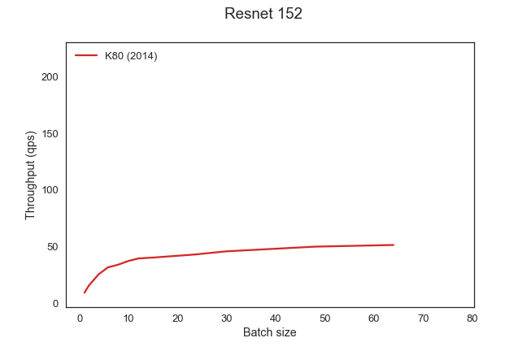
Model Performance/Cost
Latency Greedy
GPU | Cost ($/hr) | Cloud
K80 | 0.90 | AWS
P100 | 1.46 | GCP
V100 | 3.06 | AWS
Notes:
And batch size is just one of the parameters we have to consider. Resources allocated to models is another. Here we have three different types of GPUs ranging from 0.90 to over 3 dollars per hour. With the throughput difference of 4.3x between the cheapest and the most expensive GPU.
So, you might be tempted to maximize throughput for this model and go with the most expensive GPU. But what if this is not the bottleneck model? What if it’s model 1 from the previous slide? Then the extra cost is wasteful, because the pipeline is limited by the 30 qps throughput of the second model. So the right choice here is actually the cheapest GPU, as it minimizes cost without affecting throughput.
I can pick to run a model on a K80 GPU at 0.90 dollars per hour on on a V100 GPU at $3 per hour. The difference for that particular model would be 4.3x in throughput. Now what if it’s a decision I’m making for model 1 on the previous slide?

Slide 72
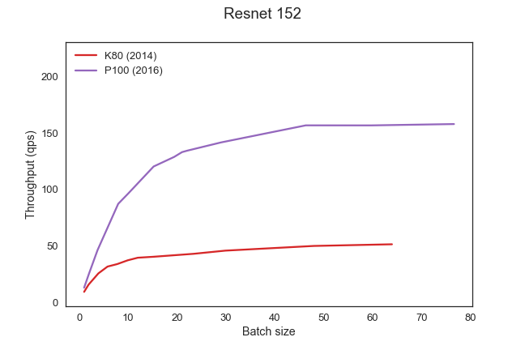
Model Performance/Cost
Latency Greedy
GPU | Cost ($/hr) | Cloud
K80 | 0.90 | AWS
P100 | 1.46 | GCP
V100 | 3.06 | AWS
Notes:
And batch size is just one of the parameters we have to consider. Resources allocated to models is another. Here we have three different types of GPUs ranging from 0.90 to over 3 dollars per hour. With the throughput difference of 4.3x between the cheapest and the most expensive GPU.
So, you might be tempted to maximize throughput for this model and go with the most expensive GPU. But what if this is not the bottleneck model? What if it’s model 1 from the previous slide? Then the extra cost is wasteful, because the pipeline is limited by the 30 qps throughput of the second model. So the right choice here is actually the cheapest GPU, as it minimizes cost without affecting throughput.
I can pick to run a model on a K80 GPU at 0.90 dollars per hour on on a V100 GPU at $3 per hour. The difference for that particular model would be 4.3x in throughput. Now what if it’s a decision I’m making for model 1 on the previous slide?

Slide 73
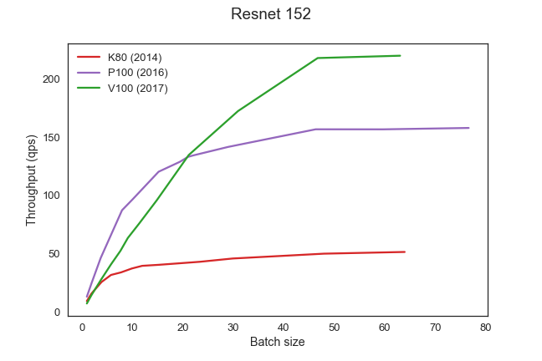
Model Performance/Cost
Model 1
Model 2
Latency Greedy
GPU | Cost ($/hr) | Cloud
K80 | 0.90 | AWS
P100 | 1.46 | GCP
V100 | 3.06 | AWS
Notes:
And batch size is just one of the parameters we have to consider. Resources allocated to models is another. Here we have three different types of GPUs ranging from 0.90 to over 3 dollars per hour. With the throughput difference of 4.3x between the cheapest and the most expensive GPU.
So, you might be tempted to maximize throughput for this model and go with the most expensive GPU. But what if this is not the bottleneck model? What if it’s model 1 from the previous slide? Then the extra cost is wasteful, because the pipeline is limited by the 30 qps throughput of the second model. So the right choice here is actually the cheapest GPU, as it minimizes cost without affecting throughput.
I can pick to run a model on a K80 GPU at 0.90 dollars per hour on on a V100 GPU at $3 per hour. The difference for that particular model would be 4.3x in throughput. Now what if it’s a decision I’m making for model 1 on the previous slide?

Slide 74
Model Configuration: Control Parameters
Batch size
Exploiting internal parallelism of the model
Physical resource allocation
GPU allocation (Usually decision is either 0 or 1)
CPU allocation
Replication factor
Exploiting external parallelism
Notes:
So we have a number of control parameters for each of the models to control: batch size, physical resource allocation, as well as the replication factor.
For each of these nodes in the DAGs you’ve just seen, there’s a number of configuration parameters that can be tuned:
What resources they run on,
What batch size the use internally
And how many replicas of each logical node in the DAG there are.

Slide 75
Problem Statement
Per-model configuration requires global reasoning
Each pipeline component contributes latency
Each model affects pipeline balance → pipeline throughput
Combinatorial number of pipeline configurations
per-model parameters: batch size, replication factor
In the number of model types
In the number of resource types
How do we capture and provision a well-balanced, cost-efficient inference pipeline?
Notes:
This brings me to the problem statement of this work : in composed inference pipelines, per-mnodel configuration requires global reasoning.
This presents us with a combinatorial number of pipeline configurations to consider.
The question is how do we capture and provision a well balanced cost-efficient inference pipeline.
==============
Capture is to grab from profiler everything the optimizer needs
Optimizer produces how to provision
When pipelining models, per-model configuration cannot be localized
First, it is important to underscore that when models are pipelined, you cannot individually configure these models in a localized fashion. In other words, in order to configure
some model in a pipeline, it can only be done by considering the effect of that on the whole pipeline. The reason for this is that it contributes latency and may miss the end-to-end latency SLO.
This configuration may also shift the throughput bottleneck in the pipeline all of a sudden increasing the effective batch size downstream, which, in turn, may increase downstream latency, which in turn may miss latency SLOs.

Slide 76
System Goals
Well-balanced inference pipeline
For heterogeneous models
On heterogeneous hardware
Cost-efficient pipeline provisioning
Minimize cost to achieve desired latency and throughput SLO
Expressive/general for arbitrary pipelines & constraints:
Conditional/probabilistic, bandits, cascades
Application throughput targets, cost budget, latency SLO
Notes:
This brings us to the goals/contributions of the system.
The primary goal of InferLine is to provision well-balanced infererence pipelines. It must be done in a cost-efficient manner and with enough flexibility to optimize for relevant constraints, such as desired throughput, cost budget, if any, and the end-to-end latency service level objective.

Slide 77
InferLine Architecture
Driver.py
Sample queries
Constraints
SLO
Throughput
Cost
Profiler
Optimizer
Per model conf
Batch size
#replicas
Resource bundle
Notes:
To that end, we’ve designed Inferline – a framework for pipelined model inference composition.
Here’s a high level overview of some of its main components.

Slide 78
InferLine Architecture
Driver.py
Sample queries
Constraints
SLO
Throughput
Cost
Optimizer
Per model conf
Batch size
#replicas
Resource bundle
Notes:
Zooming in on the Profiler, it is responsible for two things:
First, empirically extracting the DAG structure of the pipeline, given the sample queries on input.
Second, profiling individual models to evaluate their throughput and latency performance over a small set of available resource bundles.
Combining the output of these two profiling steps, the Profiler then fuses the results into algebraic expressions that serve as the interface to the Optimizer.

Slide 79
InferLine Architecture
Driver.py
Sample queries
Constraints
SLO
Throughput
Cost
Profiler
Per model conf
Batch size
#replicas
Resource bundle
Notes:
The Optimizer takes these expressions on input and compiles them to quadratic programming problems, which it subsequently solves to produce per-model configurations.
Specifically, for each model the optimizer outputs : the batch size for that model, number of replicas, and the resource bundle to use.
Examples of resource bundles, include <1GPU, 1CPU> , <0 GPU, 1CPU> . It is essentially a vector of resources allocated to a given model in the pipeline.
In the rest of the talk we are going to focus on the Optimizer, the design of its interface, and its expressive power to encode relevant inference pipelines we see in practice.

Slide 80
Conclusion
Challenges of serving increasingly complex models trained in variety of frameworks while meeting strict performance demands
Clipper adopts a container-based architecture and employs prediction caching and latency-aware batching
Ongoing efforts on a workload-aware optimizer to optimize the deployment of complex, multi-model pipelines
crankshaw@berkeley.edu
http://clipper.ai
https://github.com/ucbrise/clipper

Slide 81
Overhead of decoupled architecture
Applications
Applications
Predict
RPC Interface
Predict
RPC/REST Interface
Feedback
TensorFlow-Serving
Clipper
RPC
RPC
RPC
RPC
MC
MC
MC
MC
Caffe
Notes:
adopts a more monolithic architecture with both the serving and model-evaluation code in a single process

Slide 82
Overhead of decoupled architecture
Model: AlexNet trained on CIFAR-10
Better
P99 Latency
(ms)
Throughput
(QPS)
Better
TensorFlow Serving
Clipper*
TensorFlow Serving
Clipper*
*[NSDI 17] Prototype version of Clipper
Notes:
The performance gains from a monolithic design are minimal, but the advantages of containerized system allow us to do a lot more across different frameworks
Don’t have to re-implement all this stuff for each new framework

